Slide 1
EAP3 – Week 11
Formal-informal verbs
Academic writing
Linking words of cause and effect and time

Slide 2
Ex 5, p 130 Formal and Informal verbs
2. Acquire
3. Create
4. Maintain
5. Derive; afforded
6. Form; sustain

Slide 3
Informal Verbs
Make the informal sentences below more formal by using a more formal verb:
1) She asked for additional information.
2) She needs more training.
3) We got the documents last Tuesday.
4) The supplier gave us a quote.
5) Should I call her to say sorry?
6) Be sure to tell them about this situation.
7) We will need to book a hotel room for three nights.
8) They helped us with the paperwork.
9) Could you please check these prices?

Slide 4
Formal Verbs
Make the informal sentences below more formal by using a more formal verb:
1) She requested additional information.
2) She requires more training.
3) We received the documents last Tuesday.
4) The supplier provided us with a quote.
5) Should I call her to apologise?
6) Be sure to inform them about this situation.
7) We will need to reserve a hotel room for three nights.
8) They assisted us with the paperwork.
9) Could you please verify these prices?

Slide 5
How to Write Formally

Slide 6
Lack of direct speech and emotive language
Informal: She said, “I hate dogs!”
Formal: the young woman exclaimed that she had a strong aversion towards dogs.

Slide 7
Preference for passive
Informal: Terrorists killed 27 people in the Armagh bombing.
Formal: 27 people were killed in the Armagh bombing.

Slide 8
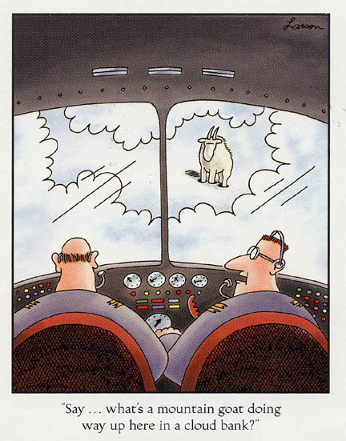
Avoidance of direct questions.
“Say…what’s a mountain goat doing way up here in a cloud bank?”

Slide 9
He asked his co-pilot why there was a mountain goat on the cloud bank.

Slide 10
Longer, more complex sentences
The historian said: ‘Hasan-e-Sabbah trained his assassins to kill his religious and political enemies’.
According to the historian, the members of the medieval persian Sect of the assassins were trained by their founder and leader, Hasan-e-Sabbah, to eliminate those who were religiously and politically opposed to him.

Slide 11
Avoid the use of personal pronouns
These include “I, you or we”
Informal: You will understand the importance of this development by now
Formal: The importance of this development is clear by now.

Slide 12
Informal: I will explain the concept at work
Formal: The concept at work will be explained.

Slide 13
Use full forms
Informal:
Marlies said she hadn’t worked so hard for years.
Geert-Jan: it isn’t that much work; you can’t expect to improve without some effort. Rome wasn’t built in a day you know.
Formal:
Marlies said she had not worked so hard for years.
Geert-Jan: it is not that much work; you cannot expect to improve without some effort. Rome was not built in a day you know.

Slide 14
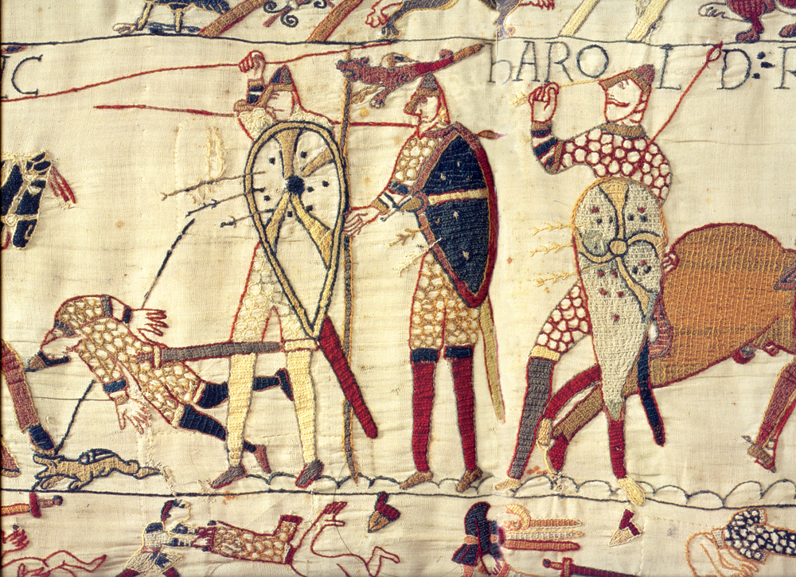
Why we have different words for the same concept.

Slide 15
Anglo-Saxon vs Latinate Verbs
Get there
Build up
Get rid of
Look up to
Do up
Get back
Build
vanish

Slide 16
Anglo-Saxon vs Latinate Verbs
Get there arrive
Build up accumulate
Get rid of eradicate
Look up to admire
Do up fasten
Get back reclaim/retrieve
Build construct
Vanish disappear

Slide 17
Avoid run on sentences
Informal: The preferred approach entails higher costs, more manpower and so on/etc/ and so forth
Formal: Two outcomes of the preferred approach are higher costs and more manpower.

Slide 18
Use appropriate negative forms
I: We don’t have any bananas (not…any)
F: We have no bananas
(no)
I: The results didn’t have much significance. (not…much)
F: The results had little significance (little)
Not…many = few

Slide 19
Hedging
This has negative consequences
This generally has negative consequences

Slide 20
Words from AWL list preferred
Academic Word List

Slide 21
The six evil words, to be avoided at all costs in formal writing
Thing
Bad
Good
Stuff
Get*
Do*
*If there is a more precise possiblity e.g. I got my results, I’ll do the tests.

Slide 22
Academic Writing
Ten ways to make your writing more academic:
http://www.dcielts.com/ielts-writing/10-wayswriting-more-academic/

Slide 23
Academic Writing: exercise
Make this text more formal by using academic language:
In the modern world, we often don’t rely on food that has been grown locally, but we have got used to buying food from all over the world. While this trend is good for consumers, I think that overall transporting food over long distances is not a good thing.
The biggest argument against importing food is environmental. We know that transport and the use of fossil fuels is the biggest cause of global warming and climate change. This means that if we want to lead a greener lifestyle, we should try not to use transport so much and this includes transporting of foodstuffs when we don’t have to.
Another point is that transporting food is bad for local farmers and traditional ways of life. This is because farmers and smallholders cannot compete in price with the supermarkets that import cheap, and often low-quality, produce from abroad. This is not just a problem for local farmers who will go out of business, it also weakens traditional communities that need those farms for employment and trade.
We should also think how food that has travelled across the world is not as good for you as locally grown, fresh produce. This is because if food travels a lot of miles before it reaches the consumer, it won’t be very fresh and experts say that fresh food is better for you. So, in my opinion, supermarkets and other stores shouldn’t transport food from other countries.
In conclusion, I think that the trend for transporting food over long distances is wrong because it is not good for the environment, it is bad for local communities and means consumers eat less healthily.

Slide 24
Paragraph 1
In the modern world, people often do not rely on food that has been produced locally, but have got used to imported foods. While this is a positive trend for consumers, the transporting of food over long distances has many disadvantages.

Slide 25
Paragraph 2
The main argument against importing food is environmental. It is known that transport and the use of fossil fuel is the primary cause of global warming and climate change. This means that to achieve a greener lifestyle, the use of transport should be reduced, including transporting of food products when unnecessary.

Slide 26
Academic Writing: KEY
In the modern world, we frequently no longer rely on food that has been grown locally, but we have become accustomed to buying produce from all over the world. While this trend has some clear benefits to consumers, it can be argued that overall transporting food over long distances should be avoided.
The strongest argument against importing food is environmental. Studies have shown that transport and the use of fossil fuels is one of the leading causes of global warming and climate change. This means that if we want to lead a greener lifestyle, we should be trying to minimise transport and this includes the unnecessary transport of foodstuffs.

Slide 27
Another point that needs to be considered is the impact of transporting food on local farmers and traditional ways of life. Again, there is good research to show that farmers and smallholders are unable to compete in price with the supermarkets that import cheap, and often low-quality, produce from abroad. This is not just a problem for local farmers who are likely to go out of business, it also has an impact on weakening traditional communities that rely on those farms for employment and trade.

Slide 28
A further consideration is that food that has travelled across the world is considerably less healthy than locally grown, fresh produce. The point is that the further food travels before it reaches the consumer, the less fresh it tends to be and experts will generally confirm that fresh food is more nutritious. Therefore, it would be preferable if supermarkets and other stores did not transport food from other countries.
In conclusion, it appears that the trend for transporting food over long distances is undesirable because it is environmentally unfriendly, threatens local communities and results in less healthy options for the consumer.

Slide 29
Linking words: cause and effect
http://web2.uvcs.uvic.ca/elc/studyzone/570/pulp/hemp6.htm

